Slide 1

ELC Molecular Epidemiology Training Real-Time Tracking of Pathogen Evolution Using Nextstrain
Leke Lyu & Tanin Rajamand
20 June 2024

Slide 2
Survey -
Introduce yourself!
Mac or PC?
Has anyone made a phylogenetic tree?
Have you done a molecular epi study?
Do you have a question that you’d like to know how to answer?
Do you have data?

Slide 3
What is genomic epidemiology?

Slide 4
Framework of molecular epi analysis
Viral genomes
Linked metadata
Evolutionary tree
Time tree
Trait evolution
Viral spread
Cross-species transmission
Notes:
Genomic epidemiology is a field that utilizes pathogen genomes to study the spread of infectious diseases through populations.
Evolution models
Clock models
Population dynamic
Trait evolutionary models

Slide 5
Genomic epidemiology
Viral genomes contain records of a virus’s transmission history.
Notes:
Imagine we have a complete transmission chain.
RNA viruses like sars-cov-2 have high mutation rates and short generation times.
This means mutations accumulate in the viral genomes during the transmission.

Slide 6
Genomic epidemiology
Viral genomes contain records of a virus’s transmission history.
Notes:
Of course we can not sample all of them

Slide 7
Genomic epidemiology
Viral genomes contain records of a virus’s transmission history.
Notes:
even if we sample only a fraction of individuals, we can still construct a phylogenetic tree that accurately represents the relationships among the sampled individuals.
Then, we can layer additional types of data on top of that tree to make inferences about transmission timing and directionality.

Slide 8
Genomic epidemiology
Epidemiologic data allows inference of transmission timing and directionality.
Notes:
We can make inference like this: there is an ongoing outbreak in the community, and it was transmitted to the university around epiweek 16.
rebuild this transmission chain really help us understand whats going on during an outbreak or pandemic
Viral genomes contain records of a virus’s transmission history.
Epidemiologic data allows inference of transmission timing and directionality.

Slide 9
What is Nextstrain ?

Slide 10
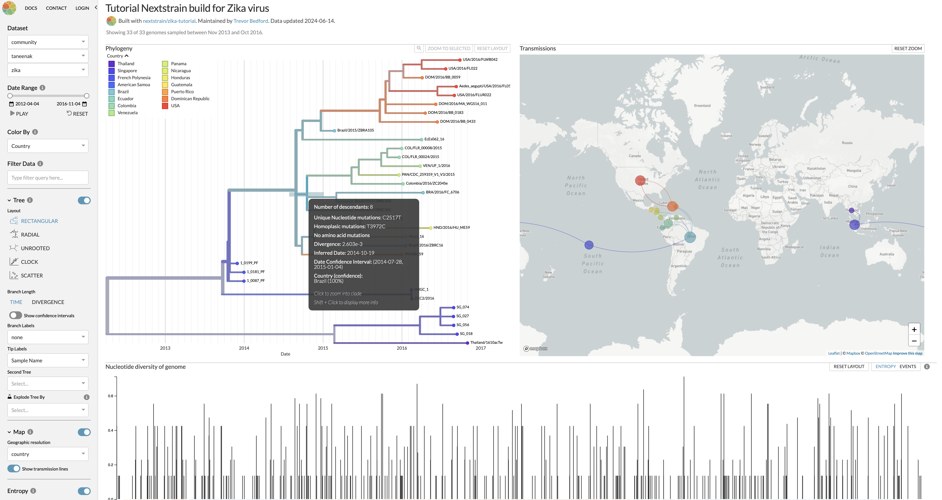
https://nextstrain.org/community/taneenak/zika

Slide 11
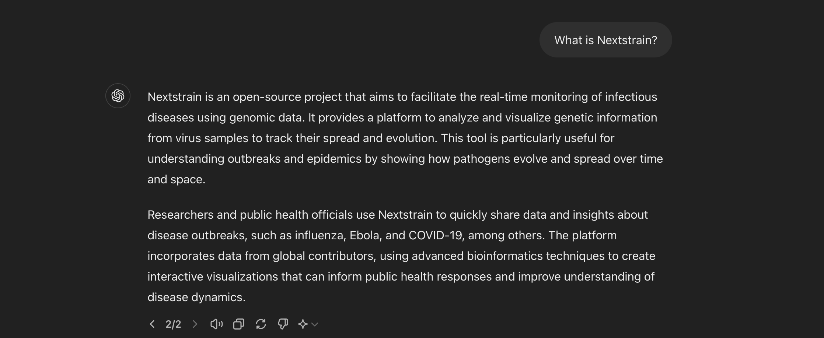
Notes:
We believe that if pathogen genome sequences are going to inform public health interventions, then analyses have to be rapidly conducted and results widely disseminated. Current scientific publishing practices often hinder the rapid dissemination of epidemiologically relevant results. An open, online system that implements robust bioinformatic pipelines to synthesize data from across research groups has the highest capacity to make epidemiologically actionable inferences.

Slide 12
Nextstrain: intro
the West African Ebola epidemic (2014-2016)
the Zika epidemic in the Americas (2015-2016)
Analyses are often done in isolation, and may lack the spatial or temporal context in which to best interpret the results
Results of analyses are rarely made available to the public or health bodies until after publication
Notes:
Nextstrain consists of data curation, analysis and visualization components.
may be too late to aid understanding or effect change in policy

Slide 13
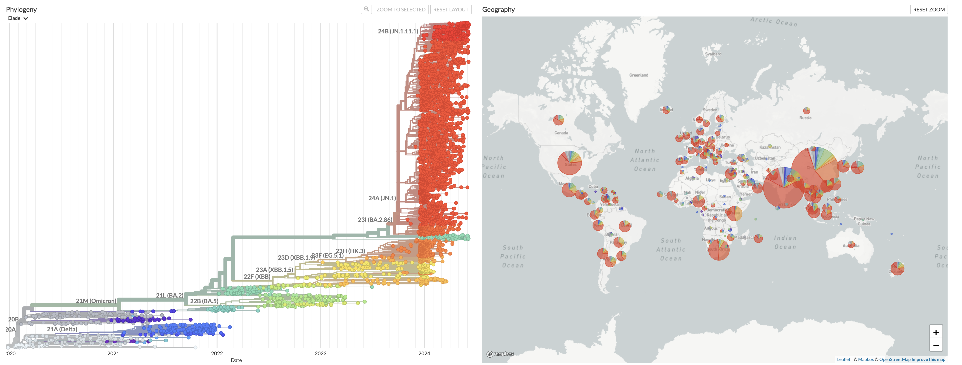
Nextstrain’s character: Joint temporal and spatial visualization
Phylogeny
Geography
Notes:
We use interactive visualizations to enable exploration of curated datasets and analyses which are continually updated when new genomes are available. This offers a powerful pathogen surveillance tool to virologists, epidemiologists, public health officials, and community scientists.

Slide 14
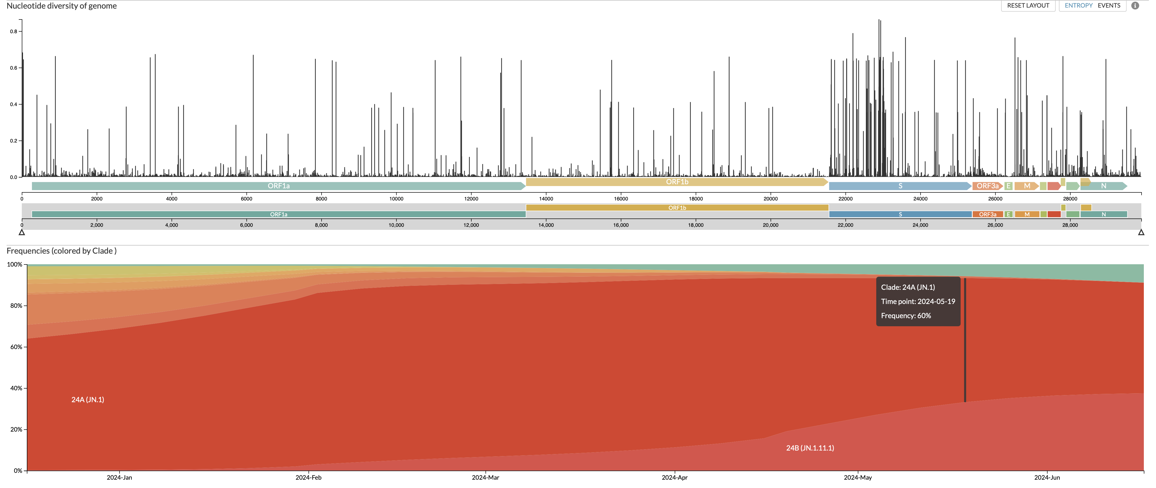
Nextstrain’s character: Monitoring of evolution and adaptation
Mutation landscape
Frequency Trends

Slide 15
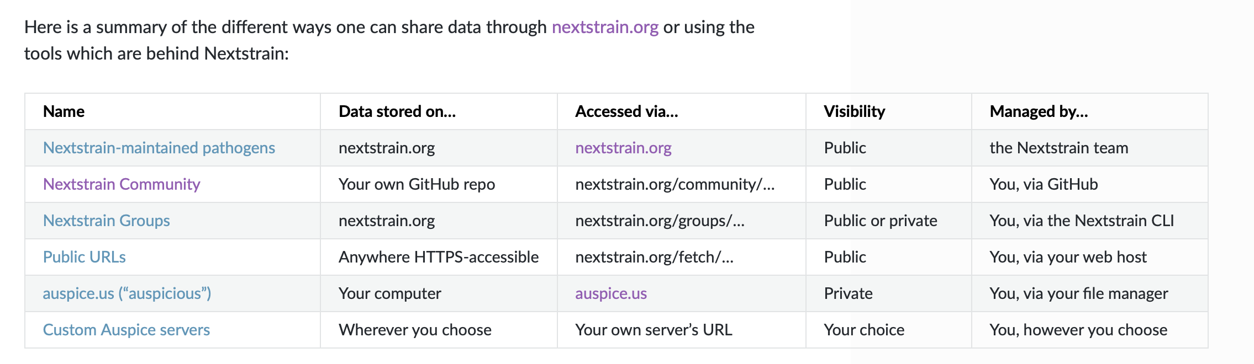
Nextstrain’s character: A model for public sharing of data
Notes:
nextstrain.org is not just our platform: we’re dedicated to supporting the work of the community through Nextstrain Groups and other sharing mechanisms. Our intent is to lower the barriers for public health organizations and research labs to both share their results publicly and collaborate privately.

Slide 16

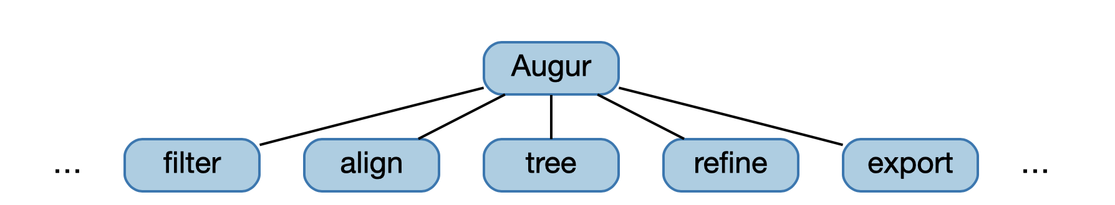
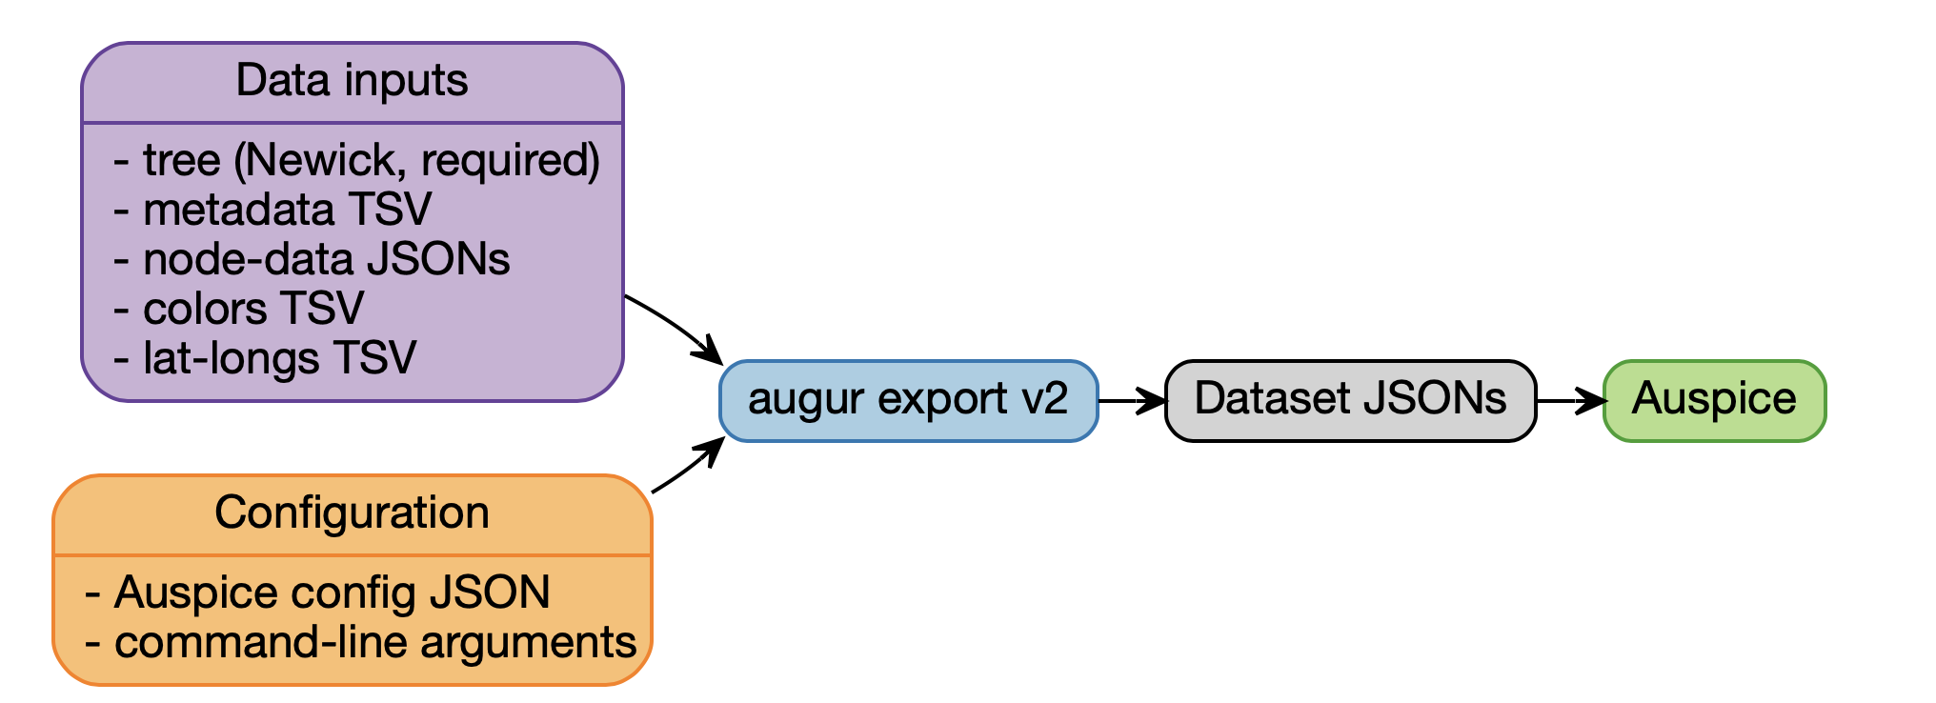
Nextstrain’s Components:
Notes:
Augur is a series of composable, modular bioinformatics tools. We use these to create recipes for different pathogens and different analyses, which can be reproduced given the same input data and replicated when new data is available.
Auspice is a web-based visualization program, to present and interact with phylogenomic and phylogeographic data.
Datasets are produced by Augur and visualized by Auspice. These files are often referred to as JSONs

Slide 17

Nextstrain Narratives Tutorial
Tanin Rajamand

Slide 18

Advanced data visualization platform 2 Panels:
One the Right: Displays dynamic Nextstrain views or static content
One the Left: Provides information about how to interpret phylogenetic trees
A single Markdown file
https://nextstrain.org/community/narratives/taneenak/zika/6202024
Notes:
Narratives are a Data-driven storytelling displayed through the Auspice view of the data
This tool has a Sidebar for navigation and descriptive text on the left and a main display panel on the right that allows users to display dynamic nextstrain views such Tree and a map or static content
you can cater it to your audience since you can provide as little or as much information you'd like
Nextstrain allows epidemiologists to quickly perform genomic epidemiology analyses from recent data, host those analyses online for interactive exploration, author narratives to describe the key results from their analyses, and then share these narratives with decision makers.
Behind the scenes a narrative is a single Markdown file written in a particular format

Slide 19
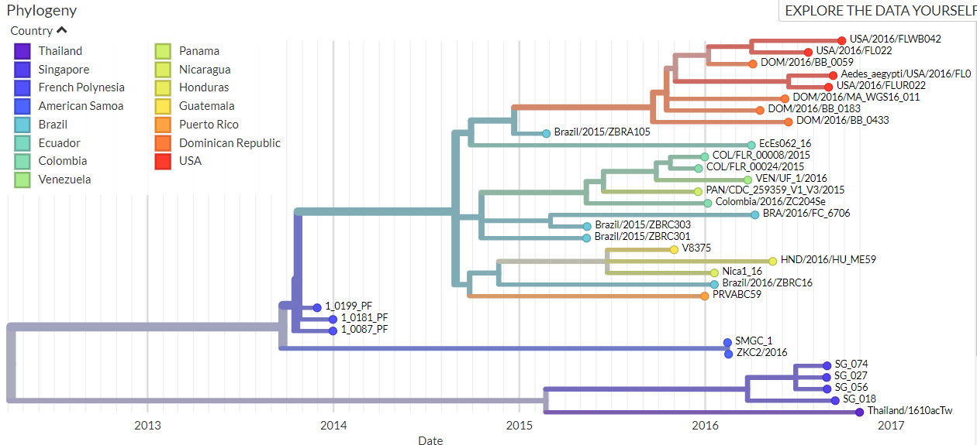
Markdown File
Markdown is a simple formatting language that lets you write text documents with basic styling.
The narratives has to sections: the title section and the slide section.
The content of this markdown include:
Title
Phylogenetic trees
Maps
Animations
Static content
Images
Links
Notes:
Title (name for the narrative)
Dataset
Listing authors by authors and authorsLinks
Listing translators by translators and translatorLinks
Abstract
Date: created and updated
Listing licenses by license and licenseLink
Phylogenetic trees
Maps
Animations
Static content
Images

Slide 20

Sharing the Results:
In this tutorial, we will use GitHub to share our results and interpretations.
We use the Zika case study as an example.

Slide 21

Getting the JSON File From a Tree:
If you saw a tree and you needed its JSON file, you can simply follow this pattern:
The tree: https://nextstrain.org/ncov/2020-03-04
to
The JSON file: https://data.nextstrain.org/ncov_2020-03-04.json
We added a data. in front of the nextstrain.org, added a .json to the end of the link and the last '/' was changed to '_'.

Slide 22
Thank you for participating!
Hadfield et al., Nextstrain: real-time tracking of pathogen evolution , Bioinformatics (2018)
Faria, Nuno R., et al., Establishment and cryptic transmission of Zika virus in Brazil and the Americas, Nature 546.7658 (2017): 406-410.

Slide 23
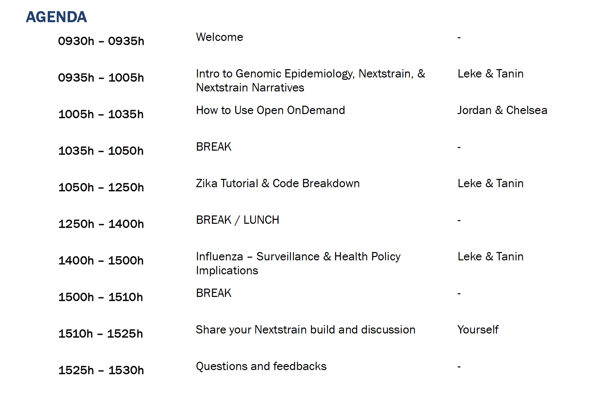

Slide 24
Check list before we proceed:
UGA MyID
Duo Mobile
Personal Github Account

